Slide 1
FINAL PROJECT
BANO QABIL (Computer information technology)

Slide 2
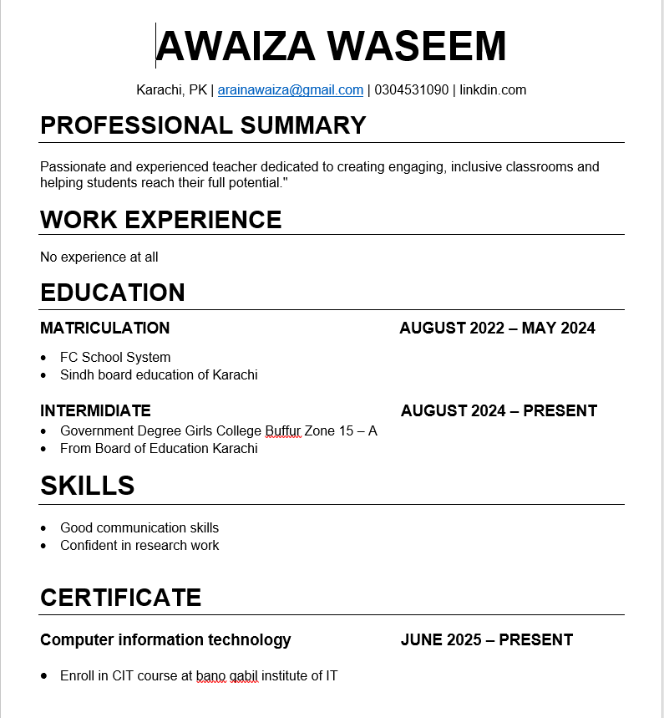
My Resume
This is the resume where I added 4 sections. And narrowed the margins , we should to remain the resume in only one page.

Slide 3
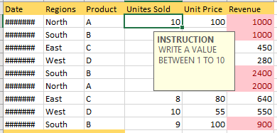
Data Validation in excel

Slide 4
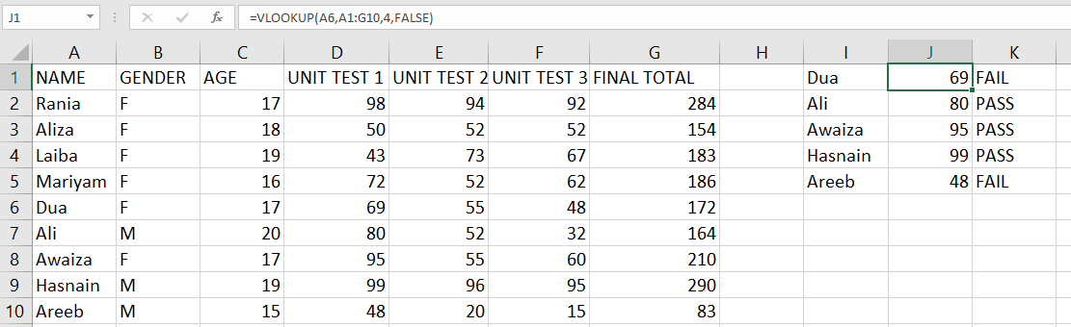
VLOOKUP in excel

Slide 5
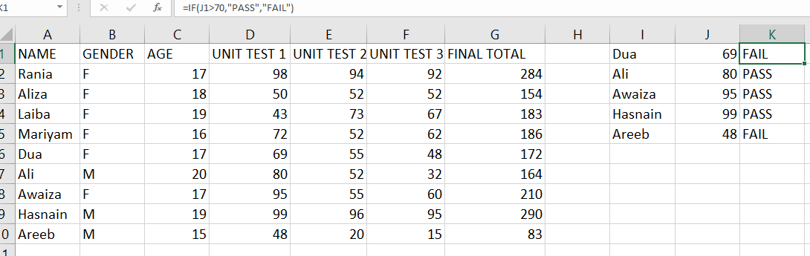
Conditional statements in excel

Slide 6
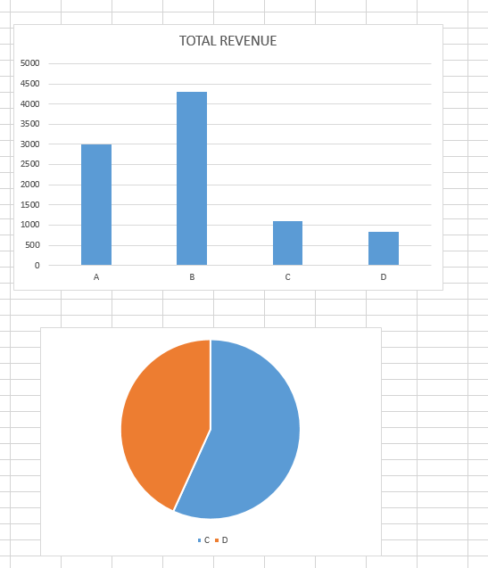
Charts/Graphs in excel

Slide 7
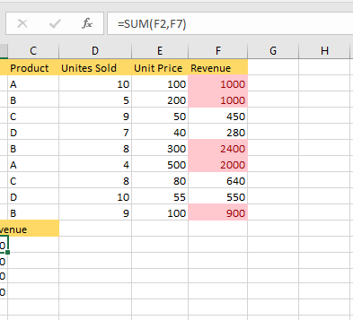
Conditional Formatting in excel

Slide 8
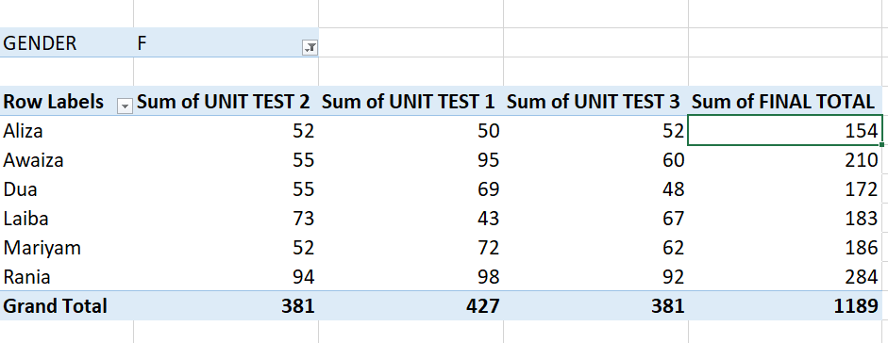
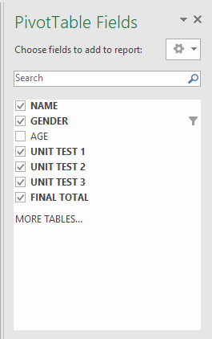
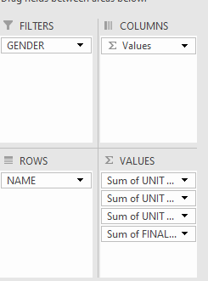
Pivot Tables in excel

Slide 9
PREASENTATION BY
AWAIZA WASEEM

